Slide 1
CLASSIFYING NEWS ARTICLES
IQRAA SHAIKH

Slide 2
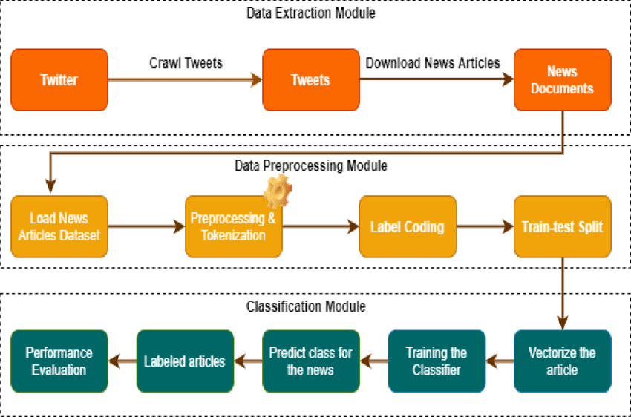
AGENDA:
This project focuses on building a model that can automatically classify news headlines into appropriate categories using machine learning method.

Slide 3

INTRODUCTION:
In today’s world, news articles are published online in huge volume everyday. Classifying these articles automatically into predefined categories (like Sports, Politics, Business, Technology, Entertainment, etc.) helps organize and filter information efficiently. Manual classification is time-consuming and inconsistent; therefore, machine learning (ML) techniques are used to automate this process.

Slide 4

TITLE:
. Classifying News Articles Using
Machine Learning
. Automatic News Category Classification
Using NLP(National Language
Processing)
. Text Classification of News Headline
Categorization.
. Machine Learning Approach for News
Headline Categorization
. Intelligent News Classification System
Using Logistics regression
and LSTM(Long Short Term Memory).

Slide 5

OBJECTIVES:
To preprocess and clean the news headline
dataset
To build and compare two classification models:
.TF-IDF + Logistic Regression (traditional ML approach)
.LSTM using GloVe embeddings (deep learning approach).
To evaluate both models using accuracy, precision,
recall, and F1-score.
To visualize model results using confusion matrices and word clouds.
To determine which model performs better and
provide recommendations.

Slide 6
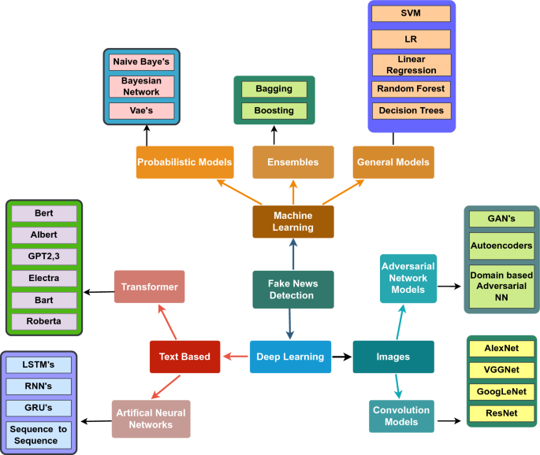
SCOPE OF THE PROJECT:
. The project uses 5-7 main categories of news, e.g.:
(Politics, Sports, Tech, Business, Entertainment,
Science, World
News).
. Models used:
(Classical ML: TF-IDF + Logistics Regression).
(Deep Learning: LSTM with pre-trained GloVe word
embeddings)
.Evaluation metrics:
( Accuracy, precision, Recall, F1-Score, Confusion Matrix).

Slide 7
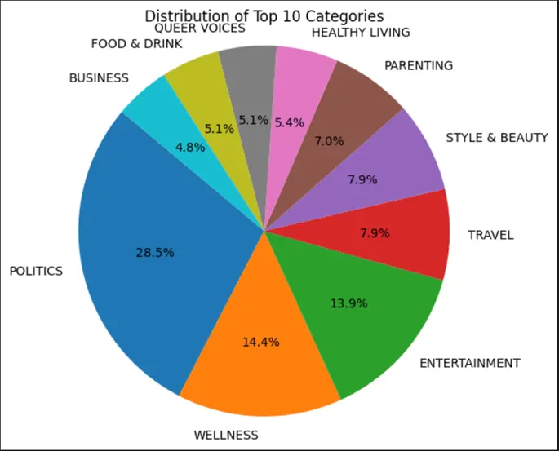
DATASET:
. Dataset Name: News Category Dataset (HuffPost).
. Sources: data.world / kaggle
. Description: Contains thousands of headlines from
the HuffPost news site, each tagged by section or
category.
. SAMPLE FEATURES:
.headline: The headline text of the article
. category: The section label, e.g., ‘POLITICS’,
‘SPORTS’.
After filtering, the project uses 5-7 key categories.

Slide 8
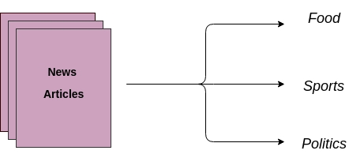
METHODOLOGY:
STEP 1:DATA PREPROCESSING
To prepare data for modeling:
. Convert text to lowercase
. Remove punctuation and special symbols
. Tokenize sentences into words
. Remove stopwords (common word like the, is, and)
. Apply Label Encoding to convert category names into numeric
form

Slide 9
STEP 2: DATA PREPROCESSING
Model 1–TF-IDF + Logistics Regression
. TF-IDF (Term Frequency-inverse Document Frequency) concerts
text into numerical features based on word importance.
. Logistic Regression is used as the classifier because it perform well
on high-dimensional text data.
. This model captures word-level importance but not word order.

Slide 10
STEP 3: DATA PREPROCESSING
Model 2– LSTM with GLoVe Embeddings
. LSTM (Long Short-Term Memory) is a type of Recurrent Neural
Network(RNN) suitable for sequential data like text.
. GloVe (Global Vectors for Word Representation) provides
pre-trained word embeddings that captures semantic meaning.
. Each headline is converted to a sequence of numbers (word
indexes) and padded to a fixed length.
. The LSTM learns contextual relationships between words in a
headline

Slide 11
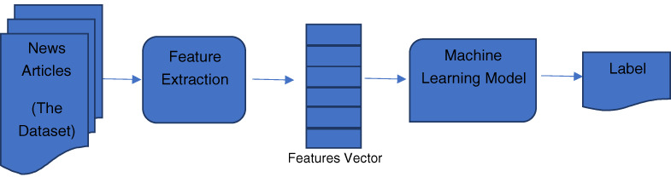
EVALUATION:
Both models are compared using:
. Accuracy: Overall percentage of correctly classified
headlines.
.Precision: Correct predictions among predicted positives.
.Recall: Correct predictions among actual positives.
.F1-Score: Harmonic mean of precision and recall.
.Confusion Matrix: Visual comparison between actual and
predicted labels.

Slide 12
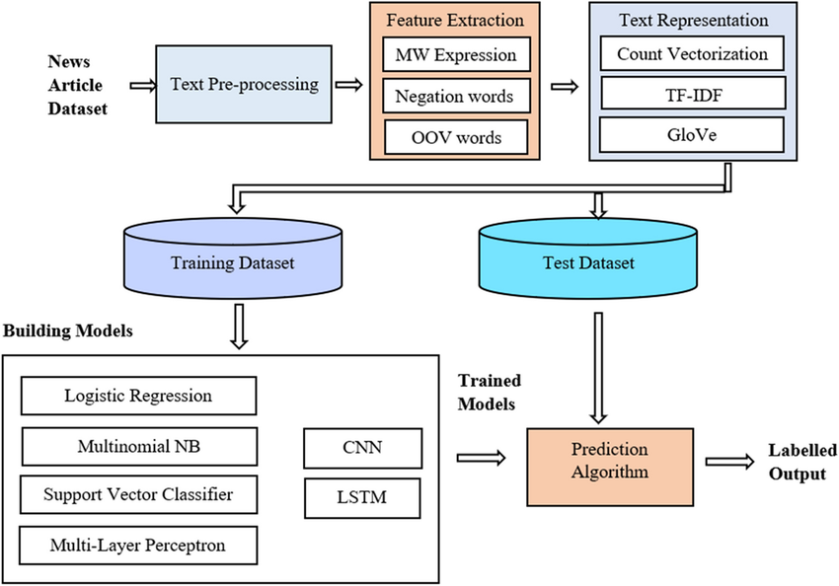
VISUALIZATION:
.Word Cloud: Displays the most frequent words per category.
. Accuracy Plot: Compares performance of Logistic Regression
and LSTM models.

Slide 13
TOOLS & TECHNOLOGIES:
CATEGORY TOOLS/LIBRARY
Programing Language python
Libraries scikit-learn, NLTK/spaCy,TensorFlow/Keras
Visualization Matplotlib, Seaborn, WordCloud
Environment Jupyter Notebook
Data Source data.world/ Kaggle

Slide 14
RESULTS & DISCUSSION:
. TF-IDF+ Logistic Regression:
. Simple and efficient for short text
(headlines).
. Achieved around 80-85% accuracy depending on dataset balance.
. LSTM + GloVe:
. Captured context and word order.
. slightly higher accuracy (~85-88%) but required more computation time.

Slide 15
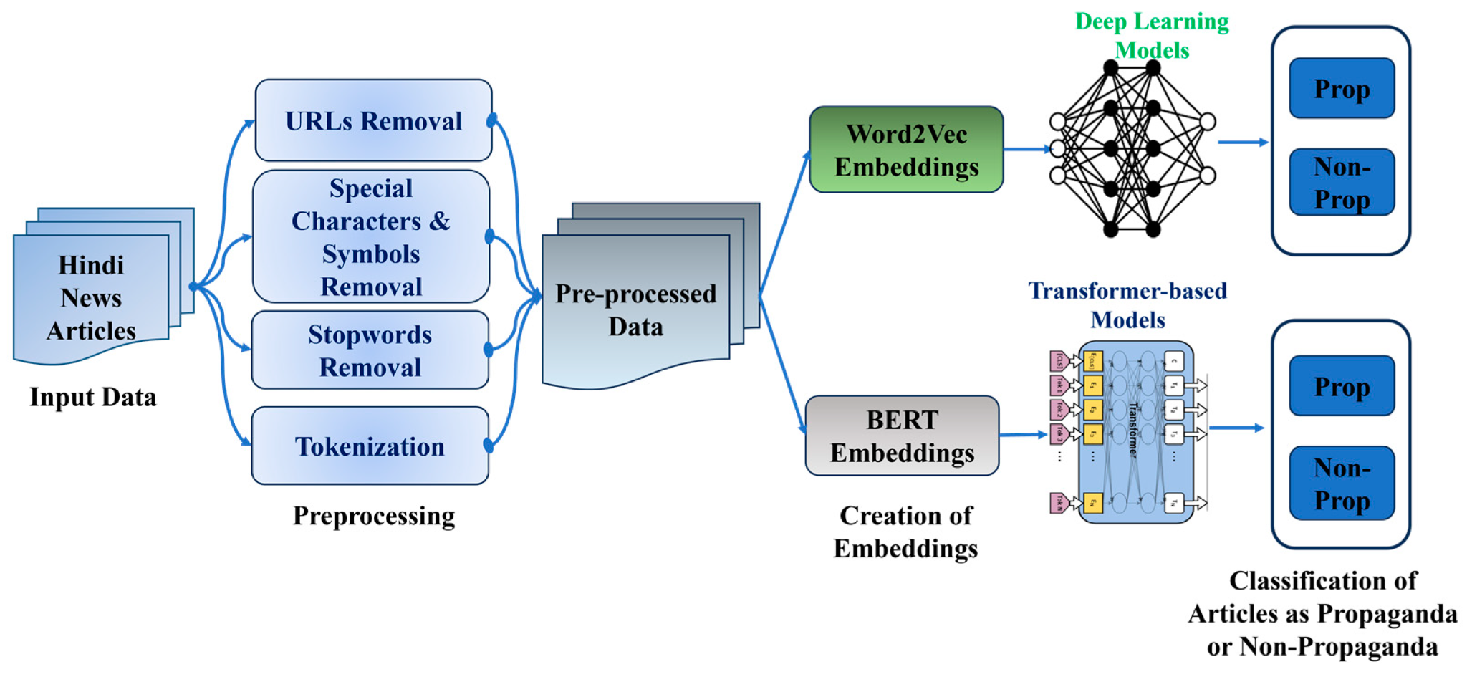
OBSERVATION:
. LSTM performs better when there are enough examples per class.
. Logistic Regression is faster and interpretable, ideal for smaller
projects.

Slide 16
CONCLUSION:
This project successfully demonstrates text classification on news headlines using both classical and deep learning approaches.
THE RESULTS SHOWS THAT:
.Logistics Regression provides a strong baseline with TF-IDF
features.
.LSTM improves classification slightly by understanding context.

Slide 17
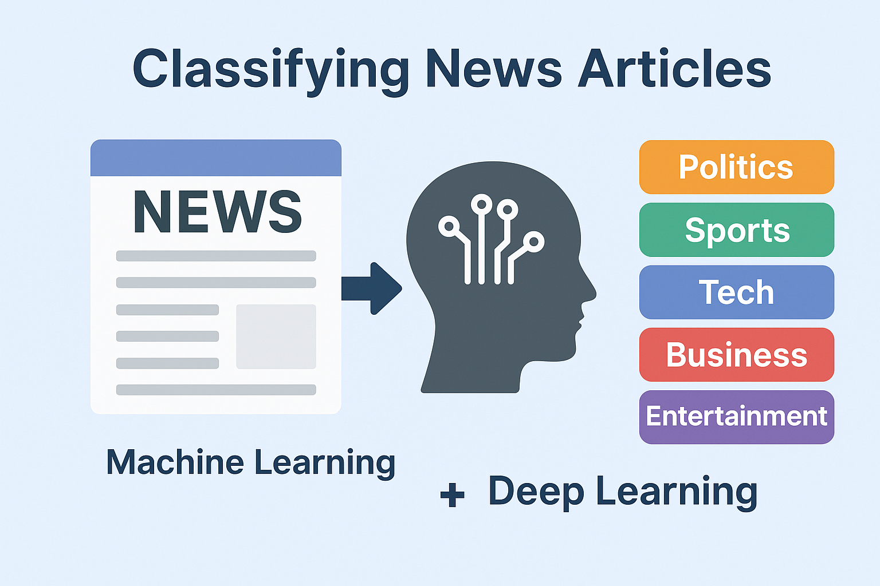
FINAL RECOMMENDATION:
Use TF-IDF+ Logistic Regression for efficiency, and LSTM
(or transformer models like BERT) for higher accuracy in large-scale systems.

Slide 18
FUTURE SCOPE:
Use transformer-based models (e.g.,BERT, DistilBERT) for better contextual understanding
2. Extend the dataset with full article text instead of only headlines.
3. Deploy as a web or API-based news classifier tool.
4.Add multilingual support to classify news in different languages.

Slide 19
Thank You!

